Slide 1


Scholarship & Financial Aid Management System
A normalized, constraint-enforced Relational Database Management System (RDBMS) designed to automate university scholarship schemes, verifications, and disbursements.
Architecture Relational Model & 3NF Schema
Engine Support MySQL / PostgreSQL / Oracle
Interface Java / Python UI Application

Slide 2

Problem Statement & Objectives
Problem Statement
Objectives:
Currently, universities process scholarships manually or through disjointed systems. This leads to severe delays in financial aid distribution, a high risk of duplicate or fraudulent claims, lost documents, and a lack of transparency for students waiting for funds.
Architect a centralized relational database normalized up to 3NF to streamline scheme setup, eligibility verification, and sanction tracking.
Enforce strict business rules via SQL constraints (PK, FK, UNIQUE, CHECK), ACID compliance, transactional integrity, and front-end interface integration.
Scope:
The system will manage the end-to-end lifecycle of university scholarships, starting from the setup of scholarship schemes by administrators to application submission by students, document verification, multi-stage approvals, and final financial disbursement and renewal tracking.
Users and Roles:
  Student: Can apply, upload documents, and track status.
  Scholarship Officer: Verifies documents and checks initial eligibility.
  University Admin/Approver: Finalizes sanctions and approves renewals.
  Finance Officer: Processes disbursements and verifies bank details.

Slide 3

Functional Requirements:
1: The system must allow administrators to define new scholarship schemes and eligibility criteria.
2: The system must allow students to submit applications and upload supporting verification documents.
3: The system must enforce mandatory document verification before an application moves to the approval stage.
4: The system must validate that a student's bank details are complete before generating a disbursement record.

Slide 4
Conceptual ER Modeling
Entity & Relationship Blueprint
The system models key domain entities including Students, Schemes, Eligibility Criteria, Applications, Documents, Verifications, Sanctions, and Disbursements.
Cardinality constraints ensure a 1:N relationship between Students and Applications, and a 1:1 binding between approved Sanctions and Bank Details for secure transaction payouts.

Slide 5





Transactional Entities
DOCUMENT
SANCTION
DISBURSEMENT
Handles the mandatory verification rule for applications.
Created only after an application is approved (within limits rule).
The actual payout record triggering the bank transfer.
DocID
DisburseID
AppID
SanctionID
SanctionID
DocType
AppID
AmountPaid
VerifyStatus
ApprovedAmt
TxnRef
ApproverName

Slide 6
Schema Normalization (1NF to 3NF)
1NF & 2NF Decomposition
3NF Transitive Dependency Removal
1NF Compliance: Eliminated multi-valued attributes by creating atomic fields and dedicated child tables for student documents and bank accounts.
3NF Compliance: Removed transitive dependencies where Scheme Max Limit was dependent on Scheme Type rather than Scheme ID.
2NF Compliance: Removed partial dependencies by ensuring all non-key attributes fully depend on complete composite primary keys (e.g., Application ID + Year).
Separated Officer details into an independent Staff relation, preventing update anomalies and maintaining clean functional dependencies across all relations.

Slide 7

Relational Schema Integrity Constraints
Constraint Type | Target Table / Attributes | Business Purpose & Enforcement
PRIMARY KEY | student_id, scheme_id, application_id | Guarantees unique entity identification across all database tables.
FOREIGN KEY | app_id → student_id, scheme_id | Maintains referential integrity with CASCADE/RESTRICT delete rules.
UNIQUE | (student_id, scheme_id, academic_year) | Strictly prevents a student from submitting duplicate claims per scheme/year.
CHECK | sanction_amount ≤ max_amount_limit | Enforces financial boundary checks at DB engine level prior to insert.
NOT NULL / DEFAULT | status DEFAULT 'PENDING', bank_ifsc | Ensures essential fields are populated and default workflow state is set.

Slide 8
Business Logic & Database Triggers
Single Active Application Rule: Database constraints prevent students from holding multiple active sanctions under the same scheme category within an academic cycle.
Mandatory Verification Gate: A SQL trigger checks that all mandatory documents carry 'VERIFIED' status before allowing an application state update to 'APPROVED'.
Financial Sanction Validation: Stored procedures verify that cumulative scheme disbursements do not exceed total allocated university scheme budget caps.
Bank Account Format Validation: RegExp CHECK constraints ensure valid account numbers and standard 11-digit IFSC codes prior to payment batch creation.

Slide 9
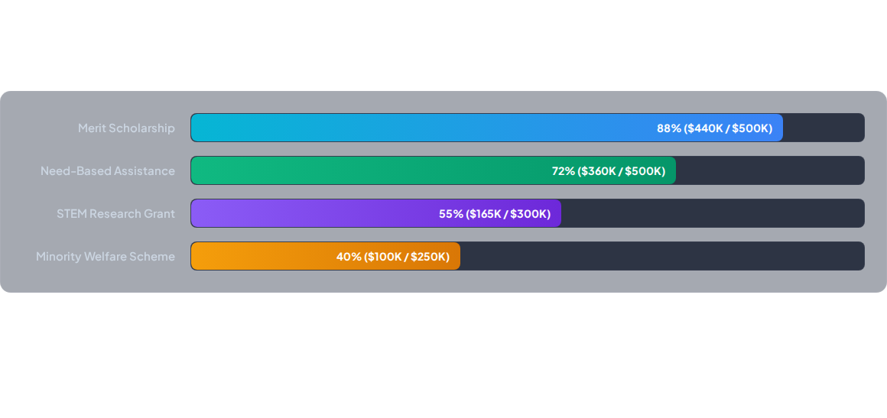
Scheme Allocation & Disbursement Stats
Analytical query leveraging SQL aggregate functions (SUM, COUNT, GROUP BY) to monitor allocated budget vs disbursed amounts per scheme category.

